Slide 1

Data Visualization
Visualize CO2 Emission from various fossil fuel.

Slide 2
What Next?
This presentation discusses the visualization process that was followed to implement the visualization.

Slide 3
Motivation
The aim of the visualization is to create awareness among the people related to CO2 Emission by various countries of world.

Slide 4

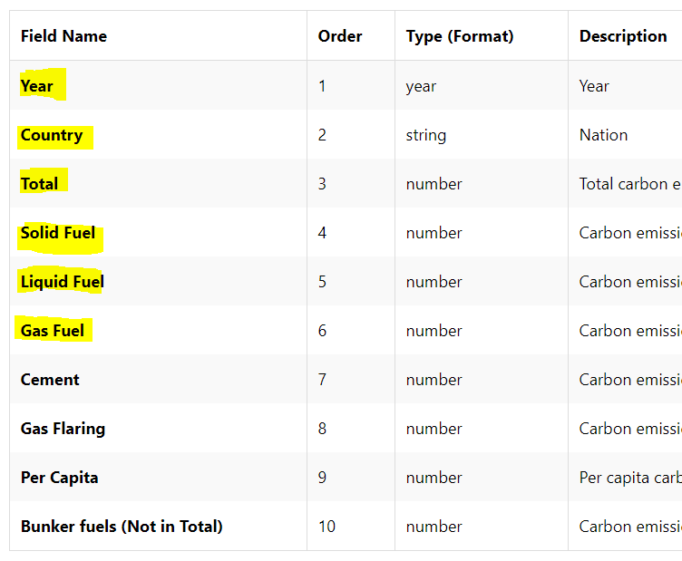
Dataset
“CO2 Emissions from Fossil Fuels since 1751, By Nation”

Slide 5
Type of Visualization
CO2
Dataset
Pie-chart on Map
Bar chart
Heat Map

Slide 6
Heat Map of CO2 Emission by Nation

Slide 7
Initial Step: Identify
 | Datatype | Visualization Task
Heat Map | -Ordered( total) -Quantitative(Location) -Nominal(Selected Countries) | Location Display countries on Map Compare Find the CO2 emission of a countries w.r.t. other countries.

Slide 8
Objective
The heat map is implemented in Tableau.
The objective is to visualize the variation in CO2 emission of various countries from 1751 to 201
The map contains the animation, which does the binning of 30 years

Slide 9


Slide 10
Visual Encoding
Encoding
Brightness | In heat map, the brightness varies based on the value of total population of a country.
Color | The color value changes in heat map, if there is major change in value.
Position | Identify the country on map

Slide 11
Comparison of Top 5 Country’s CO2 Emission in different form

Slide 12
Initial Step: Identify
 | Datatype | Visualization Task
Heat Map | -Ordered Top 5 Countries -Quantitative CO2 Emission by Gas, Liquid, and Solid Fossil Fuel | Cluster Identify top 10 countries Compare Compare the CO2 Emission by various type of Fossil Fuel

Slide 13
Objective
The Bar chart is implemented in Tableau.
The objective is to identify the top 5 countries who spread maximum pollution by CO2 emission since 1751
The chart contains the animation, which does the binning of 30 years

Slide 15
Visual Encoding
Encoding
Size | The size of bar varies based on the values
Color | Different color of bar based on category of fossil fuel

Slide 16
Top 10 countries with maximum CO2 Emission after 3rd Industrial Revolution

Slide 17
Initial Step: Identify
 | Datatype | Visualization Task
Heat Map | -Ordinal *Top 10 Countries -Quantitative *Total CO2 emission annually *CO2 Emission by Gas, Liquid, and Solid Fossil Fuel | Cluster Identify top 10 countries Compare Compare the CO2 Emission by various type of Fossil Fuel -Locate *Plot 10 countries on map

Slide 18
Objective
Implemented using Java Script and amcharts library
The objective is top 10 countries which emitted highest CO2 after 3rd Industrial Revolution.
The map contains the animation with hover and on click.

Slide 19
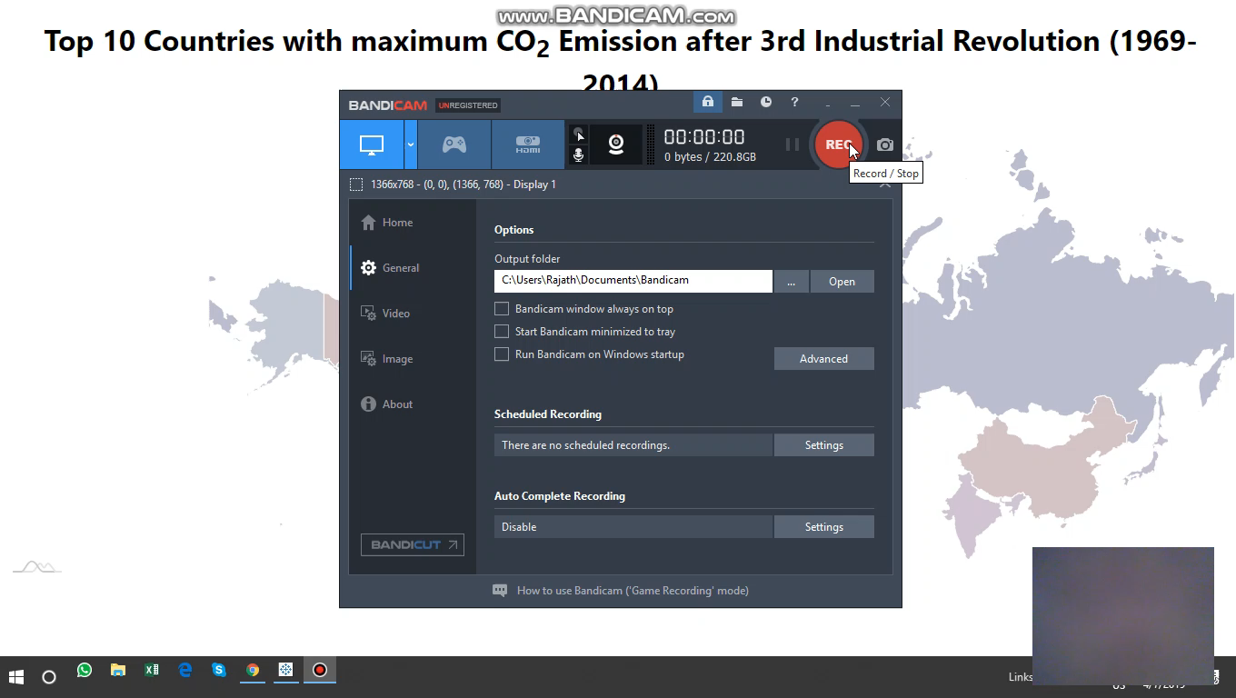

Slide 20
Visual Encoding
Encoding
Brightness | The pie chart shows the variation in brightness based on the proportion.
Color | The color value changes for pie chart of each country.
Position | Identify the country on map

Slide 21
Area of Improvement
The graph 3, have some issue in zooming out
I could have also tried to implement graph 1 & 2 with small binning size.
Moreover, I could have visualized the fossil fuel categories with donut or stack chart

Slide 22
Learning
Identify the suitable chart based on the visualization task and data type.
Developed the understanding of data visualization process.
Introduced animation in the chart and their significance.

Slide 23
Thank You

